Slide 1

CAPSTONE PROJECT
DATA 201
FARHAN SERAJ

Slide 2
NYPD RAPE CRIME PERP ANALYSIS
The goal of the project is to analyze rape crime perp from the NYPD arrest dataset.
The analysis includes the gender, age group, and race visualization.

Slide 3
DATA SOURCES
The data was collected from NYC Open Data.
The dataset has 170k Rows and 19 Columns.
The dataset belongs to NY Police Department (NYPD).

Slide 4
METHODOLOGIES
Python libraries that were used are pandas, numpy, matplotlib, and seaborn.
Functions used to remove NaN values.
Functions used to do data cleaning and data wrangling.

Slide 5
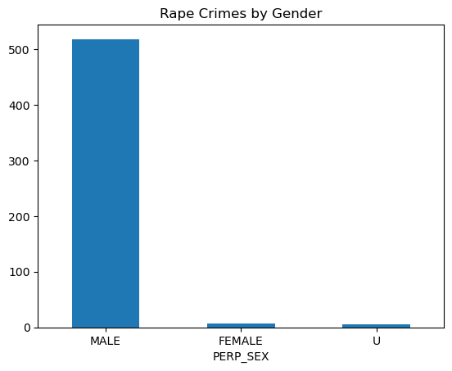
VISUALIZATION OF RAPE CRIME PERPS BY GENDER

Slide 6
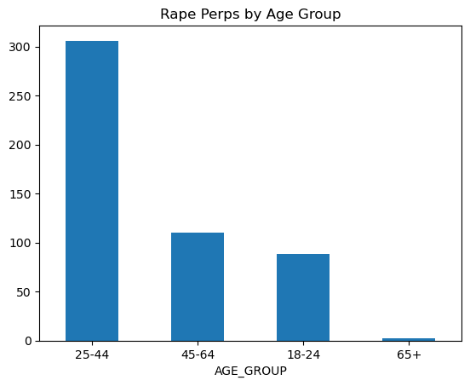
VISUALIZATION OF RAPE CRIME PERPS BY AGE GROUP

Slide 7
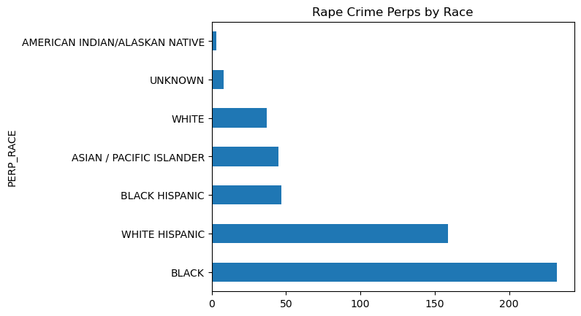
VISUALIZATION OF RAPE CRIME PERPS BY RACE

Slide 8
CONCLUSION
The Rape Crime Perp Gender is dominantly male.
The dominant Age Group is between 25-44.
The dominant Race for Rape Crime Perp is Black.

Slide 9
RESOURCES
Dataset Source: https://data.cityofnewyork.us/Public-Safety/NYPD-Arrest-Data-Year-to-Date-/uip8-fykc

